Slide 1
Terrain Generation
GLCraft dev

Slide 2
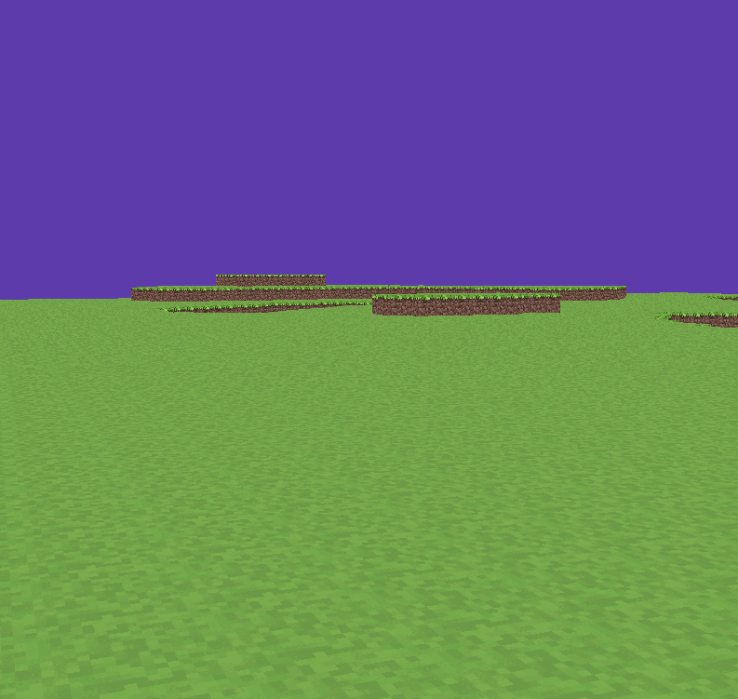
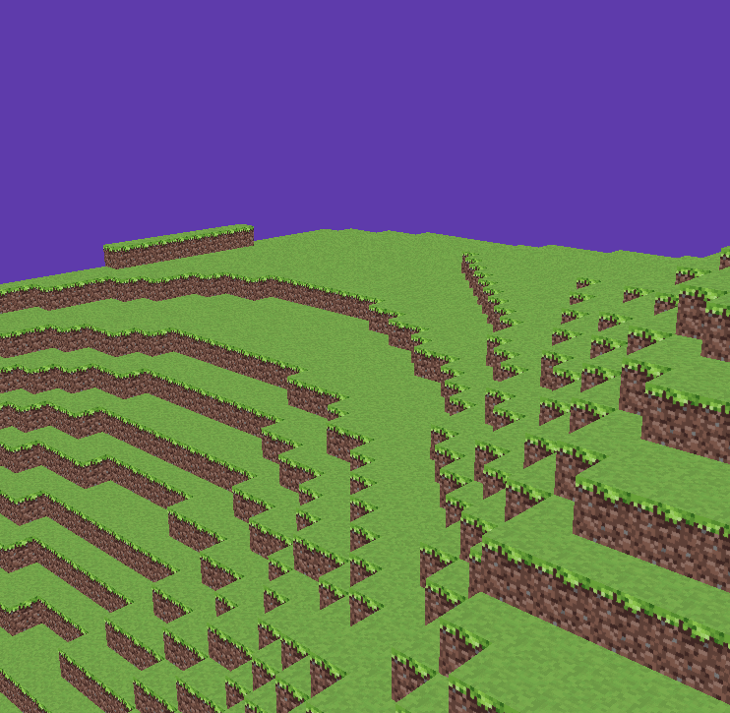
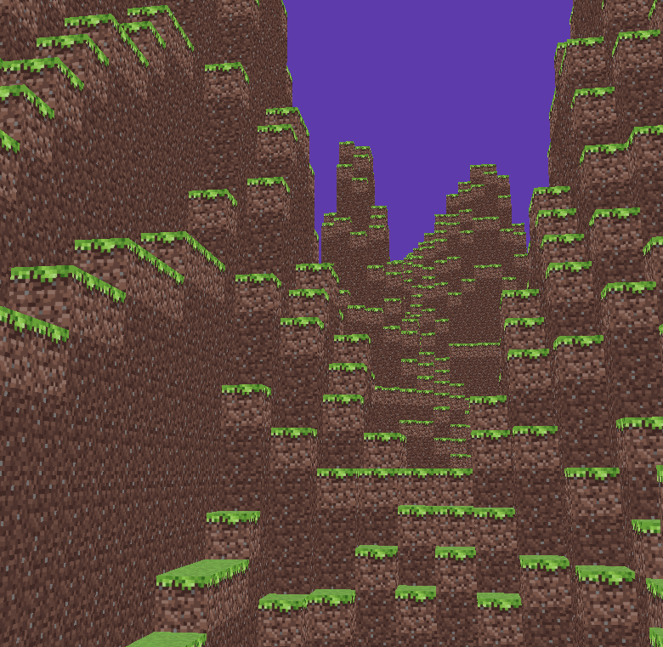
Fractal Noise
- scale: magnitude multiplier to the noise, larger scale means higher peaks and deeper vallies.
- frequency(octave): the x,z scale at which noise is sampled.
high frequency results in much rapidly changing terrain
scale:3, freq: 0.05
scale:32, freq: 0.03
scale:40, freq: 0.1/0.05(2 octaves)

Slide 3
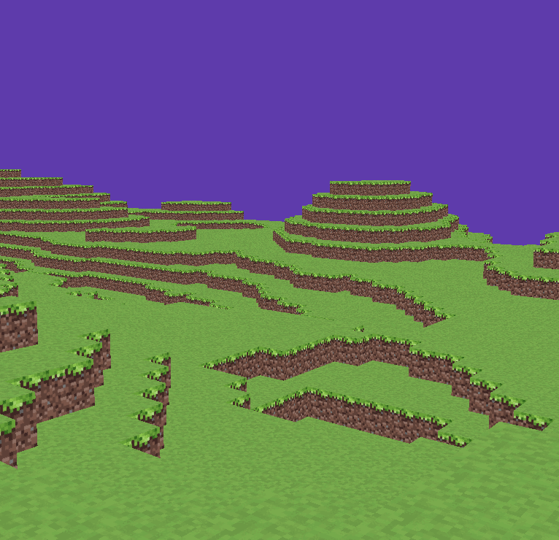
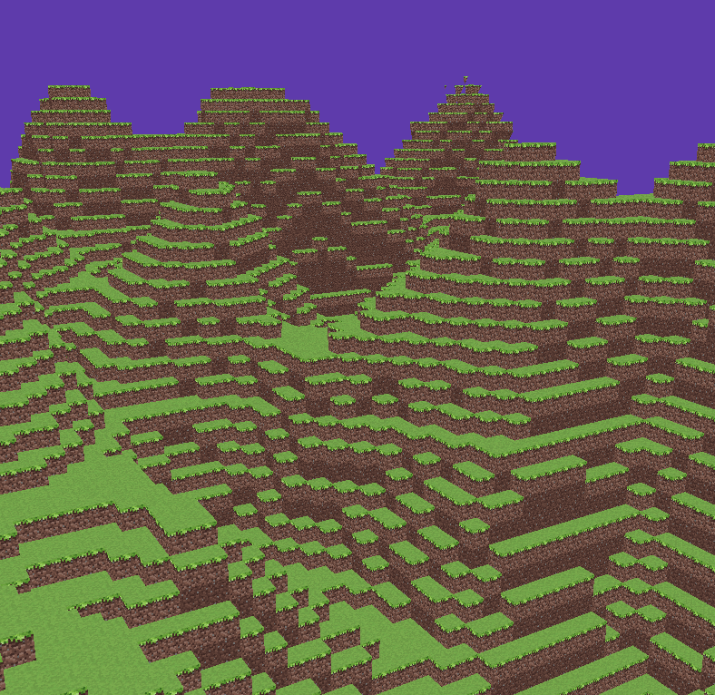
Modulation using a separate scale map.
- scale map is a slowly changing map that defines the ‘mountainness’ of the region
- height <- base_offset + base_scale * scale map(0~1) * height map
scale map 0.2~0.3
scale map 0.8~0.9

